Slide 1
Presentation on the topic “People from the IT sphere”
Pesetsky Nikita Andreevich

Slide 2
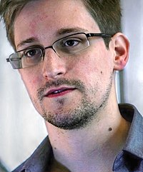
Edward Snowden
Where was he born? Edward Snowden was born on June 21, 1983 in North Carolina, USA.
Where did he come in handy?
An American technical specialist and special agent, a former employee of the CIA and the US National Security Agency (NSA).
Received awards:
Sam Adams Award (2013)
Award "For the Right Way of Life" (2014)
Stuttgart Peace Prize (2014)

Slide 3
How did Edward Snowden influence the field of iT?
He revealed the fact of comprehensive tracking of more than a billion people in 60 countries by the governments of 35 countries.
Snowden disclosed information about the PRISM program, which includes mass tracking of negotiations between Americans and foreign citizens through telephone and the Internet.
Snowden divulged information about the existence of the British tracking program Temporal, and also said that he does not use the iPhone because of the integrated software that allows you to monitor the user.

Slide 4

Snowden Award
PRESS F
In the spring of 2014, the Russian Association of Electronic Communications, the Notamedia company and the Echo of Moscow radio station jointly established the first award in the field of Internet media: "Internet Media Awards (IMA)". According to their information, Snowden personally agreed to the assignment of a new award in his name.

Slide 5

Thanks for your attention

Slide 6

Please give me a good mark.

